Slide 1
Software Quality Assurance and Testing Technology
2nd Semester, Spring 2022
Haiming Liu
School of Software Engineering
Beijing Jiaotong University

Slide 2
考试内容
简答题
大题一（等价类划分，边界值分析，参考作业2）
大题二（Basis path test ，参考作业2 ）
全英文答卷

Slide 3
Equivalence Partitioning
Idea is to partition the input space into a number of equivalence classes such that one could expect, based on the specification, that every element of a given class would be ‘‘handled’’ (i.e., mapped to
an output) in the same manner
(either correctly or incorrectly),
thus reducing the total number of test cases that must be developed.
Two types of classes are identified:
valid (corresponding to inputs deemed valid from the specification)
invalid (corresponding to inputs deemed erroneous from the specification)

Slide 4
Equivalence Partitioning
Divide all possible inputs into classes (partitions) such that : There is a finite number of input equivalence classes
You may reasonably assume that
The program behaves analogously for inputs in the same class
One test with a representative value from a class is sufficient
If the representative detects a fault, then other class members would detect the same fault
i₁
i₄
i₂
i₃
all inputs

Slide 5
Equivalence Partitioning
1. If input is a range, one valid and two invalid equivalence classes:
less than range
in range
greater than range
2. If input is a specific value, one valid and two invalid equivalence classes:
less than value
value
greater than value
3. If input is a set of related values, one valid and one invalid class:
not member of set
member of set
4. If input is Boolean, one valid and one invalid class:
nonBoolean
Boolean

Slide 6
Black-Box testing - Boundary Value Analysis (BVA)
errors hide in the corner
A technique based on identifying, and generating test cases to explore boundary conditions.
Boundary conditions are an extremely rich source of errors.
Natural language based specifications of boundaries are often ambiguous, as in ‘‘for input values of X between 0 and 40,...’’
May be applied to both input and output conditions.
Also applicable to white box testing.
more errors occur at the boundaries of an input domain than in the “center”

Slide 7
Types in Boundary
First/last
Min/Max
Star/Finish
Empty/Full
Slower/Faster
Largest/Smallest
Over/Under
Shortest/Longest
… …
Numeric
Character
Position
Quantity
Speed
Location
Size

Slide 8
Examples of possible boundary conditions
Limits on input data – size, type
Limits on output data- size, type
Look for limits such as
First-1/Last+1
Start-1/Finish+1
Min-1/max+1
Less than empty/ more than full
just Over/Just Under
etc.
Don’t hesitate to choose data outside boundaries, even when it seems absurd.

Slide 9
Boundary Values
Based on experience / heuristics :
Testing boundary conditions of eq. classes is more effective i.e. values directly on, above, and beneath edges of classes
Choose input boundary values as tests in input classes instead of, or additional to arbitrary values
Choose also inputs that invoke output boundary values ( values on the boundary of output classes )
Example strategy as extension of equivalence partitioning:
choose one (n) arbitrary value(s) in each eq. class
choose values exactly on lower /upper boundaries of eq. class
choose values immediately below /above each boundary ( if applicable )

Slide 10
Guidelines for Identifying Boundary Values
1. If the input range is bounded by a and b, then use a, b, and values just above and just below a and b, respectively.
a
b
2. If the input is a number of values, use the minimum and maximum of the values and values just above and just below them, respectively.
a
b
3. Apply guidelines 1 and 2 to create output values at the minimum and maximum expected values.
4. If data structures have boundaries, test these boundary values and values just above and just below them, respectively.
e.g., for an array of bounds 1 to 10
— test array index equal to 0, 1,2, 9, 10, 11

Slide 11
Guidelines for choosing Equivalence classes For Data Testing
Identify sub-boundary conditions or internal boundary conditions
Some limits may not be apparent to the general end user.
To locate some of these, you may need to talk with programmers.
Example: Powers-of-two boundary conditions

Slide 12
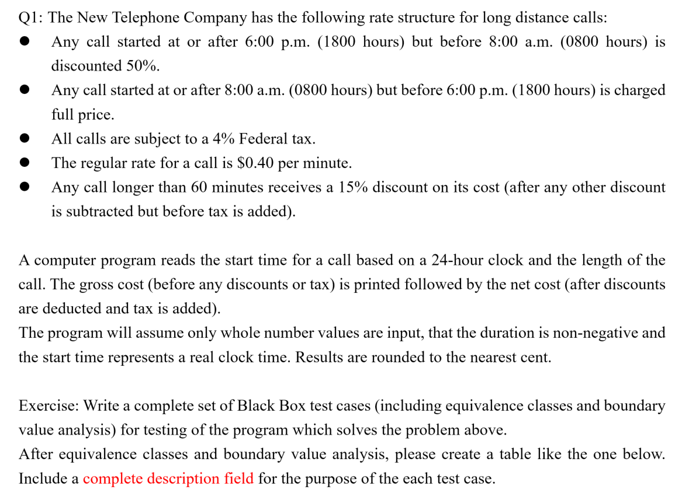
Assignment 2 Q1

Slide 13
Conditions
18:00 ~8:00
8:00~18:00
4%
$0.4/min
>60min 15%

Slide 14
Equivalence Partitioning(EP)
Valid

Slide 15
Equivalence Partitioning(EP)
Valid
 | Call | Duration | Cost
Partition1(a) | [18:00 ~8:00) | n>60 | N*0.4*(1-15%)*50%*(1+4%)
Partition1(b) | [18:00 ~8:00) | 0<=n<=60 | N*0.4*50%*(1+4%)
Partition2(a) | [8:00~18:00) | n>60 | N*0.4*(1-15%)*(1+4%)
Partition2(b) | [8:00~18:00) | 0<=n<=60 | N*0.4*(1+4%)
Invalid
Negative n
Impossible clock time 24:01
Impossible input

Slide 16
Boundary Value Analysis (BVA)
Valid
 | Call | Duration | Cost
Partition1(a) | [18:00 ~8:00) | n>60 | N*0.4*(1-15%)*50%*(1+4%)
Partition1(b) | [18:00 ~8:00) | 0<=n<=60 | N*0.4*50%*(1+4%)
Partition2(a) | [8:00~18:00) | n>60 | N*0.4*(1-15%)*(1+4%)
Partition2(b) | [8:00~18:00) | 0<=n<=60 | N*0.4*(1+4%)
Partition1(a)
Call start at
18:00
18:01
17:59
8:00
8:01
7:59
Duration
61min
60min
59min
Max?
Cost？

Slide 17
Boundary Value Analysis (BVA)
Valid
 | Call | Duration | Cost
Partition1(a) | [18:00 ~8:00) | n>60 | N*0.4*(1-15%)*50%*(1+4%)
Partition1(b) | [18:00 ~8:00) | 0<=n<=60 | N*0.4*50%*(1+4%)
Partition2(a) | [8:00~18:00) | n>60 | N*0.4*(1-15%)*(1+4%)
Partition2(b) | [8:00~18:00) | 0<=n<=60 | N*0.4*(1+4%)
Partition1(b)
Call start at
18:00
18:01
17:59
8:00
8:01
7:59
Duration
61min
60min
59min
0min
1min

Slide 18
Boundary Value Analysis (BVA)
Valid
 | Call | Duration | Cost
Partition1(a) | [18:00 ~8:00) | n>60 | N*0.4*(1-15%)*50%*(1+4%)
Partition1(b) | [18:00 ~8:00) | 0<=n<=60 | N*0.4*50%*(1+4%)
Partition2(a) | [8:00~18:00) | n>60 | N*0.4*(1-15%)*(1+4%)
Partition2(b) | [8:00~18:00) | 0<=n<=60 | N*0.4*(1+4%)
Partition2(a)
Call start at
18:00
18:01
17:59
8:00
8:01
7:59
Duration
61min
60min
59min
Max?

Slide 19
Boundary Value Analysis (BVA)
Valid
 | Call | Duration | Cost
Partition1(a) | [18:00 ~8:00) | n>60 | N*0.4*(1-15%)*50%*(1+4%)
Partition1(b) | [18:00 ~8:00) | 0<=n<=60 | N*0.4*50%*(1+4%)
Partition2(a) | [8:00~18:00) | n>60 | N*0.4*(1-15%)*(1+4%)
Partition2(b) | [8:00~18:00) | 0<=n<=60 | N*0.4*(1+4%)
Partition2(b)
Call start at
18:00
18:01
17:59
8:00
8:01
7:59
Duration
61min
60min
59min
0min
1min

Slide 20
Boundary Value Analysis (BVA)
Valid
 | Call | Duration | Cost
Partition1(a) | [18:00 ~8:00) | n>60 | N*0.4*(1-15%)*50%*(1+4%)
Partition1(b) | [18:00 ~8:00) | 0<=n<=60 | N*0.4*50%*(1+4%)
Partition2(a) | [8:00~18:00) | n>60 | N*0.4*(1-15%)*(1+4%)
Partition2(b) | [8:00~18:00) | 0<=n<=60 | N*0.4*(1+4%)
Partition1(a)
Call start at
18:00
18:01
7:59
Duration
61min

Slide 21
Boundary Value Analysis (BVA)
Valid
 | Call | Duration | Cost
Partition1(a) | [18:00 ~8:00) | n>60 | N*0.4*(1-15%)*50%*(1+4%)
Partition1(b) | [18:00 ~8:00) | 0<=n<=60 | N*0.4*50%*(1+4%)
Partition2(a) | [8:00~18:00) | n>60 | N*0.4*(1-15%)*(1+4%)
Partition2(b) | [8:00~18:00) | 0<=n<=60 | N*0.4*(1+4%)
Partition1(b)
Call start at
18:00
18:01
7:59
Duration
60min
59min
0min
1min

Slide 22
Boundary Value Analysis (BVA)
Valid
 | Call | Duration | Cost
Partition1(a) | [18:00 ~8:00) | n>60 | N*0.4*(1-15%)*50%*(1+4%)
Partition1(b) | [18:00 ~8:00) | 0<=n<=60 | N*0.4*50%*(1+4%)
Partition2(a) | [8:00~18:00) | n>60 | N*0.4*(1-15%)*(1+4%)
Partition2(b) | [8:00~18:00) | 0<=n<=60 | N*0.4*(1+4%)
Partition2(a)
Call start at
8:00
8:01
17:59
Duration
61min

Slide 23
Boundary Value Analysis (BVA)
Valid
 | Call | Duration | Cost
Partition1(a) | [18:00 ~8:00) | n>60 | N*0.4*(1-15%)*50%*(1+4%)
Partition1(b) | [18:00 ~8:00) | 0<=n<=60 | N*0.4*50%*(1+4%)
Partition2(a) | [8:00~18:00) | n>60 | N*0.4*(1-15%)*(1+4%)
Partition2(b) | [8:00~18:00) | 0<=n<=60 | N*0.4*(1+4%)
Partition2(b)
Call start at
8:00
8:01
17:59
Duration
60min
59min
0min
1min

Slide 24
Test Case
Case # | Description | Input Values | Expected Output
1 | Partition1(a) | Call start at 18:00 , Duration 61min
2 | Partition1(a) | Call start at 18:01, Duration 61min
3 | Partition1(a) | Call start at 7:59, Duration 61min
4 | Partition1(a) | Call start at 18:28 , Duration 100min
... | Partition1(a) ??
Notes:
因为这里两个条件，其实是可以分别做的，这里做了个简化，类似于单因素和多因素
主要考虑同学们对于条件的考虑
这里把边界条件考虑到就可以了

Slide 25
TESTING FUNDAMENTALS EXAMINING THE CODE

Slide 26
Basic Path Testing
Goal: exercise each independent path at least once.
Using the code, draw a corresponding flow graph
Determine the cyclomatic complexity of the flow graph.
Determine a basis set of linearly independent paths.
Prepare test cases that force the execution of each path in the basis set.

Slide 27

Flow graph from code
Flow graphs Consist of Three Primitives
A decision is a program point at which the control can diverge.
(e.g., if and case statements).
A junction is a program point where the control flow can merge.
(e.g., end if, end loop, goto label)
A process block is a sequence of program statements uninterrupted by either decisions or junctions. (i.e., straight-line code).
A process has one entry and one exit.
A program does not jump into or out of a process.

Slide 28
Basis path test
A path through a program is a sequence of statements that starts at an entry, junction, or decision and ends at another (possible the same), junction, decision, or exit.
A path may go through several junctions, processes, or decisions, one or more times.
Paths consist of segments.
The smallest segment is a link. A link is a single process that lies between 2 nodes.
The length of a path is the number of links in a path.
An entry/exit path or a complete path is a path that starts at a routine’s entry and ends at the same routine’s exit.
1
2
3
4

Slide 29
Basis path test
Complete paths are useful for testing because:
It is difficult to set up and execute paths that start at an arbitrary statement.
It is difficult to stop at an arbitrary statement without changing the code being tested.
We think of routines as input/output paths.
Path Selection Criteria
There are many paths between the entry and exit points of a typical routine.
Even a small routine can have a large number of paths.

Slide 30
Example
Procedure: process records
Do While records remain
Read record;
If record field 1 = 0 Then
store in buffer;
increment counter;
Else If record field 2 = 0 Then
reset counter;
Else store in file;
End If
End If
End Do
End
Procedure: process records
Do While records remain
Read record;
If record field 1 = 0 Then
store in buffer;
increment counter;
Else If record field 2 = 0 Then
reset counter;
Else store in file;
End If
End If
End Do
End

Slide 31
Example (continued)
Procedure: process records
1. Do While records remain
2. Read record;
3. If record field 1 = 0 Then
4. store in buffer;
5. increment counter;
6. Else If record field 2 = 0 Then
7. reset counter;
8. Else store in file;
9. End If
10. End If
11. End Do
End
1
2
3
6
4
8
7
9
5
10
11

Slide 32
Basis path test example: FLOW GRAPH
1
2,3
6
4,5
8
7
9
10
11

Slide 33
Determine cyclomatic complexity of flow graph
Cyclomatic complexity: a quantitative measure of the logical complexity of code, provides an upper bound on the number of paths that need to be tested in the code
modules
Higher Cyclomatic Complexity, more possibility in error
V(G)
modules in this range are more error prone
V(G) =number of regions (areas bounded by nodes and edges—area outside the graph is also a region)
V(G) = number of edges - the number of nodes + 2
V(G) = number of (simple) predicate nodes + 1

Slide 34
V(G) =number of regions (areas bounded by nodes and edges—area outside the graph is also a region)
1
Region 1
Region 4
2,3
6
4,5
Region 2
7
Region 3
8
9
10
V(G)=4
11

Slide 35
V(G) = number of edges - the number of nodes + 2
Node 1
Edge 11
1
Edge 1
Node 2
2,3
Node 3
Edge 8
Edge 2
6
Node 7
Edge 10
Edge 3
4,5
Edge 4
Node 4
Node 5
Edge 9
7
8
Edge 5
Edge 6
Node 6
Edge 7
9
Node 8
10
V(G)=4
11
Node 9

Slide 36
V(G) = number of (simple) predicate nodes + 1
Node 1
1
Node 2
2,3
Node 3
6
4,5
7
8
9
10
V(G)=4
11

Slide 37
Determine a basis set of linearly independent paths
Independent path any path that introduces at least one new set of processing statements or a new condition
Basis set set of independent paths through the code
Test cases derived from a basis set are guaranteed to execute every statement at least one time during testing
Basis set is not unique

Slide 38
Basis path test example
V(G)=4
1
Path1: 1-11
2,3
Path2: 1-2-3-6-7-9-10-1-11
6
4,5
Path3: 1-2-3-6-8-9-10-1-11
7
8
9
Path4: 1-2-3-4-5-10-1-11
10
11

Slide 39
Basis path test example 1
scanf(“%d %d”,&x, &y)
if (y < 0)
pow = -y;
else
pow = y;
z = 1.0;
while (pow != 0) {
z = z * x;
pow = pow - 1;
}
if (y < 0)
z = 1.0 / z;
printf (“%f”,z);
Please draw the control flow graph of the following code and provide the cyclomatic complexity V(G) of the control flow graph;
Please provide the Basis Path set of the control flow graph;
【腾讯文档】Basis path test example 1
https://docs.qq.com/form/page/DSFdHVllleEZnQnVa

Slide 40
Basis path test example 2
for (j=1; j<N; j++)
{
3 last = N - j + 1;
4 for (k=1; k<last; k++)
5 {
6 if (list[k] > list[k+1])
7 {
8 temp = list[k];
9 list[k] = list[k+1];
10 list[k+1] = temp;
11 }
12 }
13 }
14 print(“Done\n”);
【腾讯文档】Basis path test example 2
https://docs.qq.com/form/page/DSEF5cXRYeUdnTlhY

Slide 41
Basis path test example 3
/* COUNT
This program counts the number of characters and lines in a text file.
INPUT: Text File
OUTPUT: Number of characters and number of lines.
*/
1 main(int argc, char *argv[])
2 {
3 int numChars = 0;
4 int numLines = 0;
5 char chr;
6 FILE *fp = NULL;
7
8 if (argc < 2)
9 {
10 printf(“\nUsage: %s <filename>”, argv[0]);
11 return (-1);
12 }
13 fp = fopen(argv[1], “r”);
14 if (fp == NULL)
15 {
16 perror(argv[1]); /* display error message */
17 return (-2);
18 }
【腾讯文档】Basis path test example 3
https://docs.qq.com/form/page/DSGVGSmpkSU1MR25k
19 while (!feof(fp))
20 {
21 chr = getc(fp); /* read character */
22 if (chr == ‘\n’) /* if carriage return */
23 ++numLines;
24 else
25 ++numChars;
26 }
27 printf(“\nNumber of characters = %d”, numChars);
28 printf(“\nNumber of lines = %d”, numLines);
29 }

Slide 42
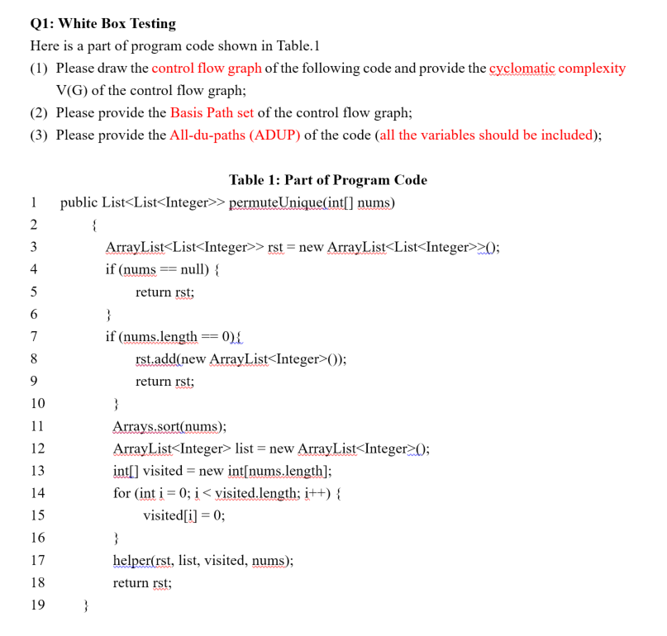
Assignment 3 Q1

Slide 43
Assignment 3 Q1
1 public List<List<Integer>> permuteUnique(int[] nums)
2 {
3 ArrayList<List<Integer>> rst = new ArrayList<List<Integer>>();
4 if (nums == null) {
5 return rst;
6 }
7 if (nums.length == 0){
8 rst.add(new ArrayList<Integer>());
9 return rst;
10 }
11 Arrays.sort(nums);
12 ArrayList<Integer> list = new ArrayList<Integer>();
13 int[] visited = new int[nums.length];
14 for (int i = 0; i < visited.length; i++) {
15 visited[i] = 0;
16 }
17 helper(rst, list, visited, nums);
18 return rst;
19 }

Slide 44
Assignment 3 Q1
1
1 public List<List<Integer>> permuteUnique(int[] nums)
2 {
3 ArrayList<List<Integer>> rst = new ArrayList<List<Integer>>();
4 if (nums == null) {
5 return rst;
6 }
7 if (nums.length == 0){
8 rst.add(new ArrayList<Integer>());
9 return rst;
10 }
11 Arrays.sort(nums);
12 ArrayList<Integer> list = new ArrayList<Integer>();
13 int[] visited = new int[nums.length];
14 for (int i = 0; i < visited.length; i++) {
15 visited[i] = 0;
16 }
17 helper(rst, list, visited, nums);
18 return rst;
19 }
2
3
5
4
20
7
8
9
11
12
13
14
17
18
15
16

Slide 45
Assignment 3 Q1
1
1
2
2
3
5
3
5
4
4
20
20
7
8
9
7
8,9
11
12
11,12,13
13
14
17
18
14
17,18
15
15,16
16

Slide 46
Assignment 3 Q1
1
2
3
5
4
Region 1
20
Region 4
7
8,9
Region 2
11,12,13
V(G)=4
14
17,18
Region 3
15，16

Slide 47
Assignment 3 Q1
1
2
3
5
4
20
7
8,9
11,12,13
14
17,18
15
16

Slide 48
Assignment 3 Q2
1 public static void bubbleSort(int[] array)
2 {
3 int tmp;
4 boolean flag = false;
5 for(int i = array.length-1;i >= 0;i--)
6 {
7 for(int j=0;j<i;j++)
8 {
9 if(array[j]>array[j+1])
10 {
11 tmp = array[j];
12 array[j] = array[j+1];
13 array[j+1] = tmp;
14 flag = true;
15 }
16 }
17 if(!flag) break;
18 }
19 }

Slide 49
Assignment 3 Q2
1 public static void bubbleSort(int[] array)
2 {
3 int tmp;
4 boolean flag = false;
5 for(int i = array.length-1;i >= 0;i--)
6 {
7 for(int j=0;j<i;j++)
8 {
9 if(array[j]>array[j+1])
10 {
11 tmp = array[j];
12 array[j] = array[j+1];
13 array[j+1] = tmp;
14 flag = true;
15 }
16 }
17 if(!flag) break;
18 }
19 }
1
2
3
4
5
19
6
18
7
17
8
9
10
11
12
16
15
14
13

Slide 50
Assignment 3 Q2
1
1
2
3
2,3,4
4
5
19
5
19
6
18
6
18
7
17
7
17
8
8
9
10
11
12
9
10,11,12,13,14,15
16
15
14
13
16

Slide 51
Assignment 3 Q2
1
2,3,4
Region 5
5
19
Region 1
6
18
Region 2
7
17
8
Region 4
9
Region 3
10,11,12,13,14,15
V(G)=5
16

Slide 52
Assignment 3 Q2
1
2,3,4
5
19
6
18
7
17
8
9
10,11,12,13,14,15
16

Slide 53
To be continued… See you next week

